Slide 1
Data processing and graph visualisation of tumour and t-cell detections
Yannis laaroussi
Bachelor thesis – Final presentation

Slide 2
Content
Data processing (3 conversions between data type)
Visualisation (GUI, display graph on an image)
Data processing
Initial Data
New
Data
Linda’s data processing pipeline
New
Data
Visualisation

Slide 3
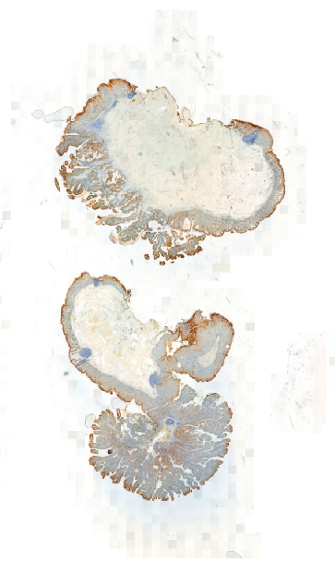
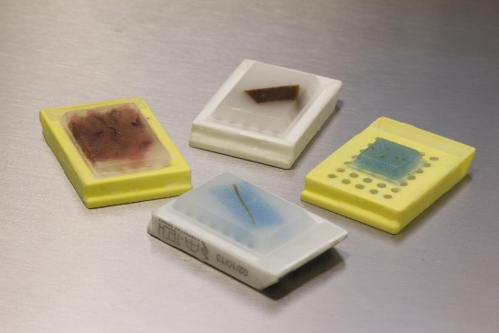
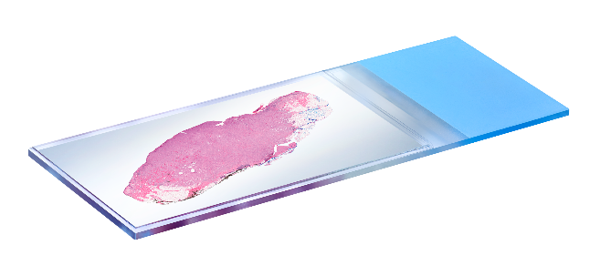
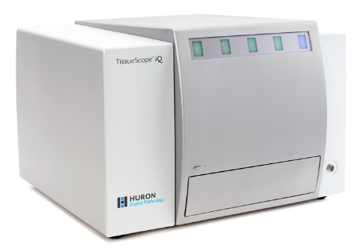
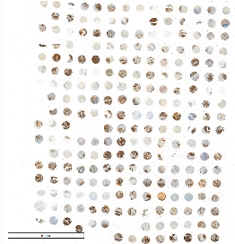
Dataset overview
Interested data
(images)
Paraffin blocks¹
Tiny slides²
Scanner³
cut
send
digitize
1. https://www.biochain.com/blog/what-is-ffpe-tissue-and-what-are-its-uses/ 2. https://www.hurondigitalpathology.com/ 3. https://www.hurondigitalpathology.com/tissuescope-iq-2/

Slide 4
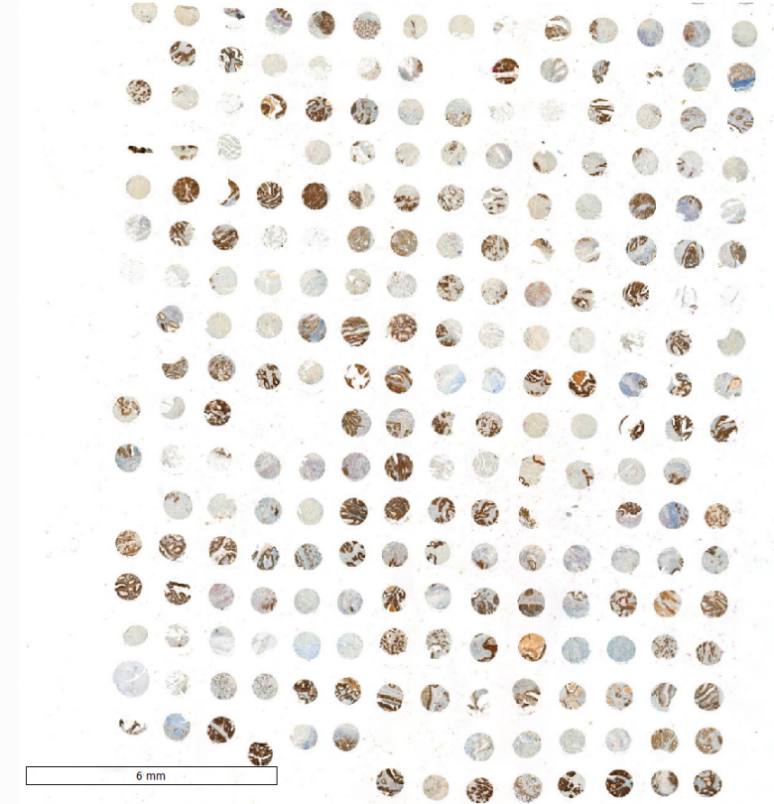
Different types of image
Whole slide image
MRXS type
90’000 - 120’000 pixels
Tissue micro array (TMA)
MRXS type
90’000 - 120’000 pixels
Contains many area of interests

Slide 5
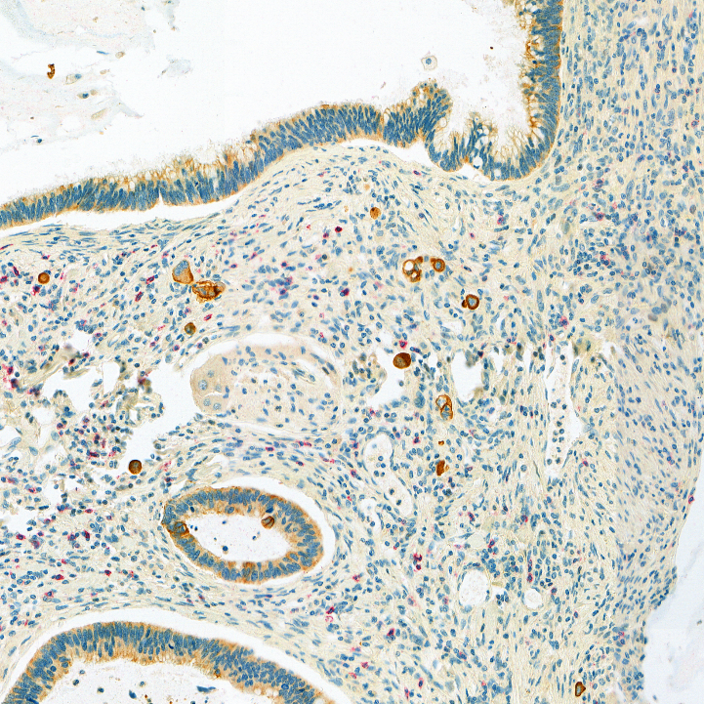
Hotspot image
Tumor budding hotspot
PNG type
~340 images
3600 x 3600 pixels
JSON file associated
Area
Center of mass
Centroid
Circularity
Classification
Solidity
Min/max Diameter
Number of cells
Object index (ID)
ROI points

Slide 6
Open images
2 softwares:
QuPath
ASAP
+ Suitable for processing (a lot of) hotspot images
+ Holds features (area, centroid, circularity, …)
- Slower to process MRXS image
+ Suitable for processing MRXS image
- Contains only the annotations (ROI points)
- Cannot process PNG/JPEG image

Slide 7
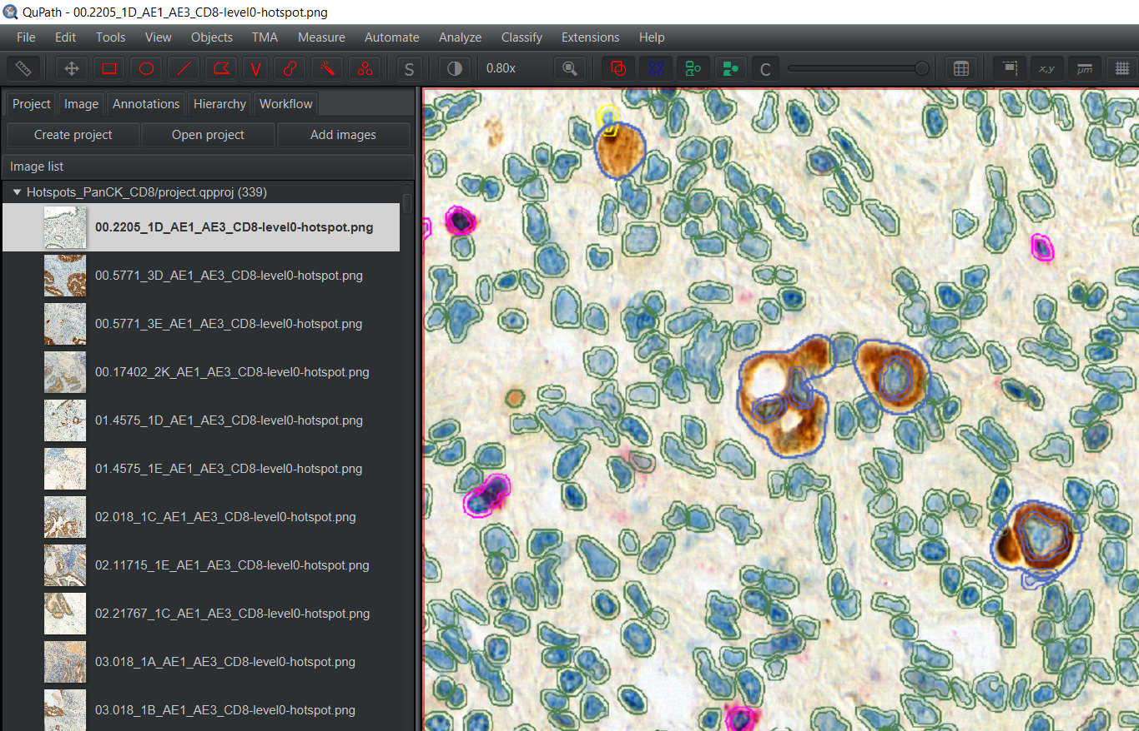
qupath
Tumor buds (brown spot)
Bounded by polygons
+ Extra information : area, center of mass, …
=> Stored in the JSON file
Notes:
Explain purpose of QuPath : software to visualize particular region. Tumor, Cells, bounded by polygons. Also we have some information about each cells like perimeter, area, center of mass, …

Slide 8
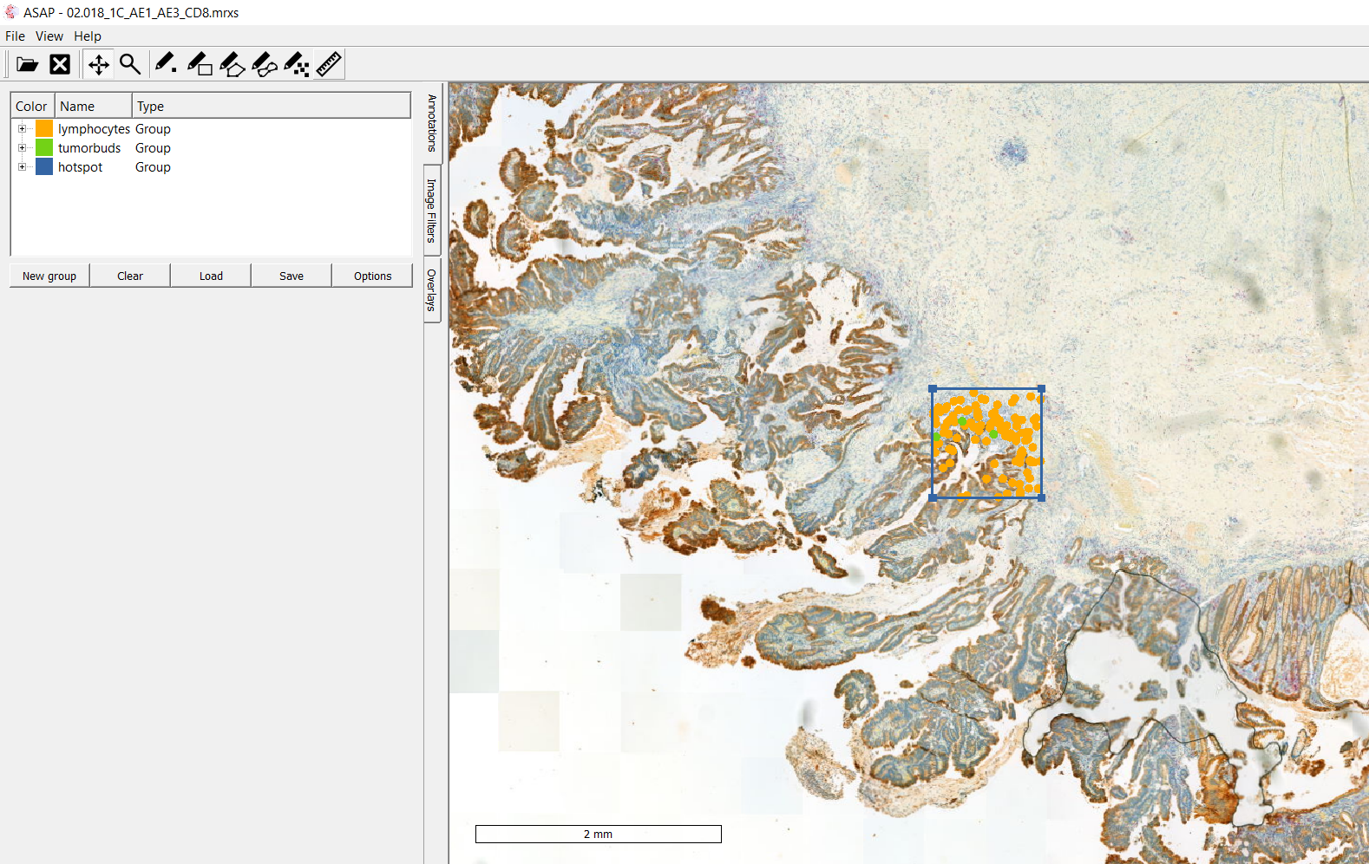
Asap
Visualisation using XML file to drawn annotations on whole slide image or TMA
Notes:
Second software asap to use xml file in order to see on a full medical picture a particular hotspot, xml file used for phd project, whole slide image -> tumor budding hotspot

Slide 9



Data processing
Conversion 1: JSON (+XML) to XML for drawing annotations on ASAP on the whole slide image
Annotations
Hotspot coordinates

Slide 10
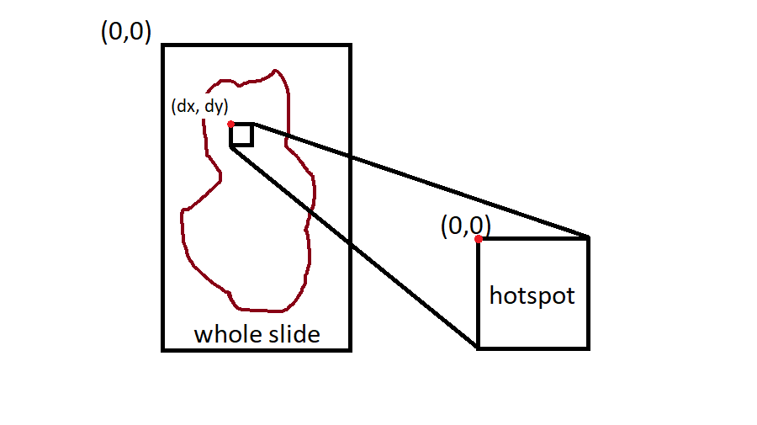
Resolution
Open JSON file
Read each ROI points (X, Y)
Open XML file
Read the offset (dx, dy)
For each ROI points, shift the coordinates: (X + dx, Y + dy)
Write the new coordinates into the XML output file

Slide 11
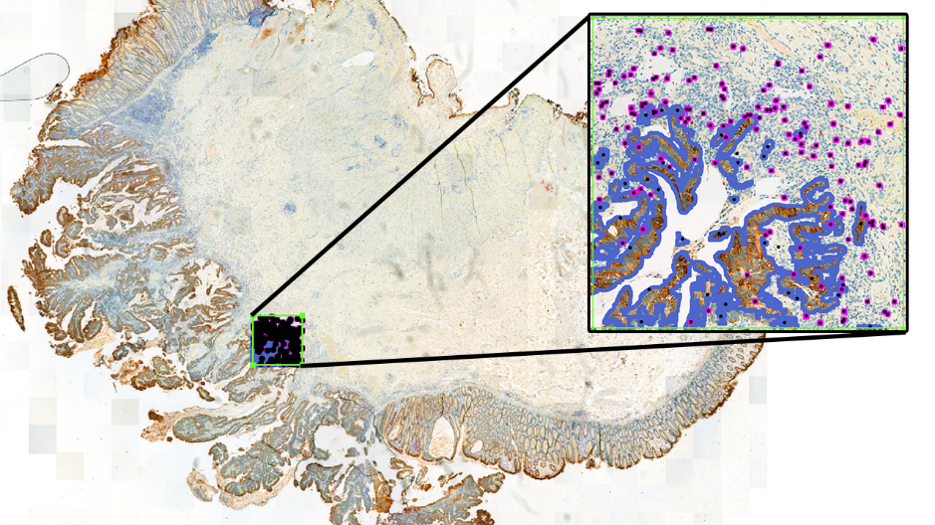
result

Slide 12
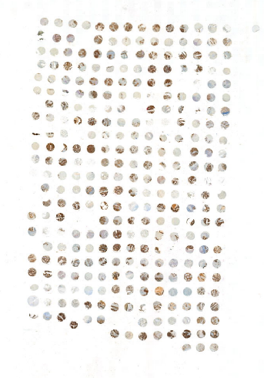

Conversion 2: JSON (+CSV) to XML for drawing annotations on ASAP on the tissue micro array
Center of hotspot coordinates & radius
Annotations

Slide 13
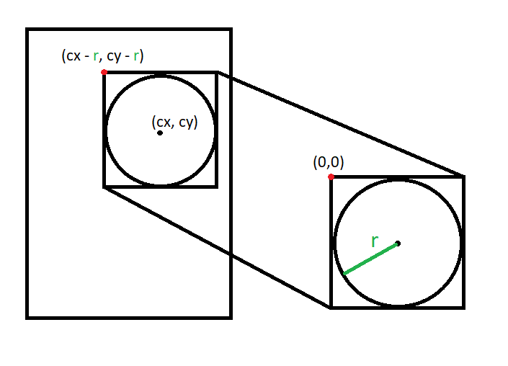
resolution
Open JSON file
Read each ROI points (X, Y)
Open CSV file
Read the center coordinates (cx, cy) and the radius r
For each ROI points, shift the coordinates: (X + cx - r, Y + cy - r)
Write the new coordinates into the XML output file

Slide 14
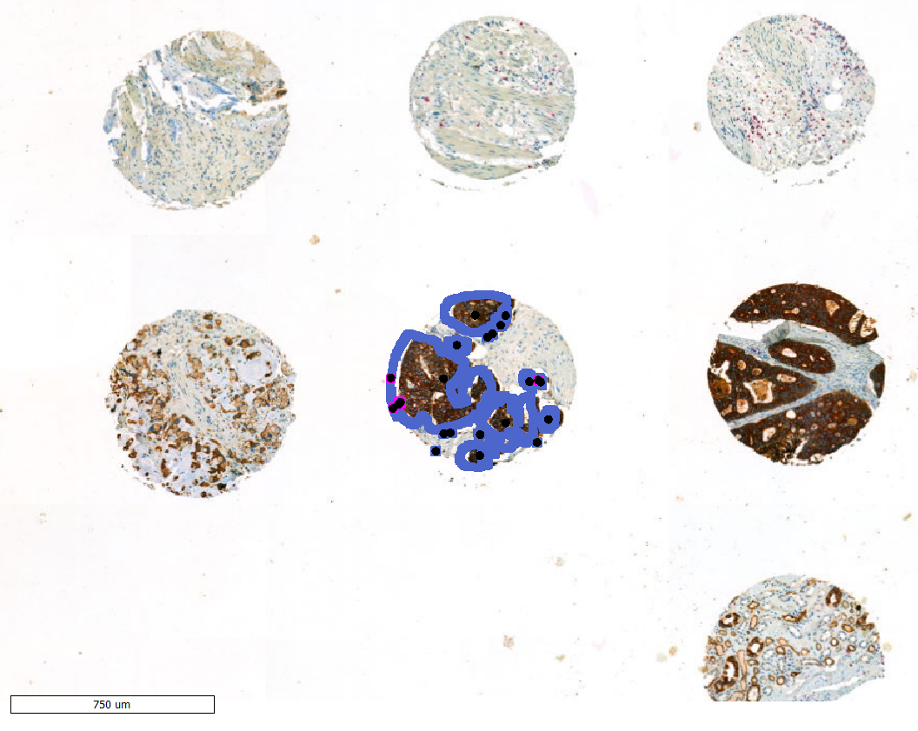
result

Slide 15

Conversion 3: JSON to CSV for opening the other features (area, circularity, solidity, …) on Excel
Features

Slide 16
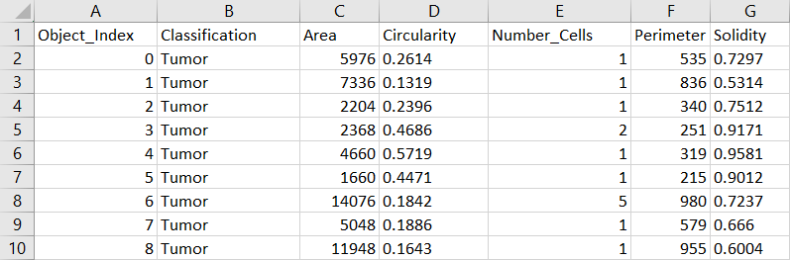
Resolution & Result
Open JSON file
Read each interested features
Write the values in the CSV output file

Slide 17
VIsualisation
Data processing
Initial Data
New
Data
Linda’s data processing pipeline
New
Data
Visualisation
XML file readable by ASAP
GXL file

Slide 18
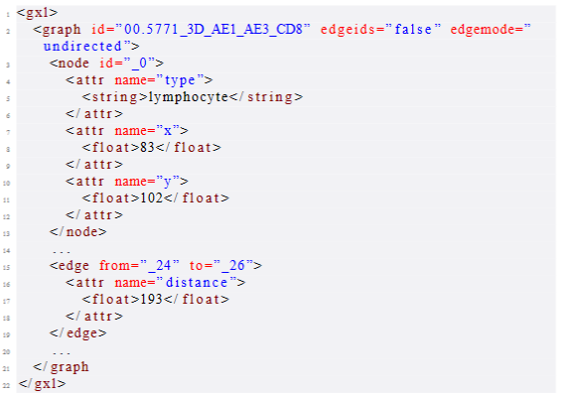
Gxl file
XML like format
dedicated for graph storage
One element by node identified by an ID
Each node contains at least the x and y attributes
One element by edge containing the ids of the two nodes composing it

Slide 19
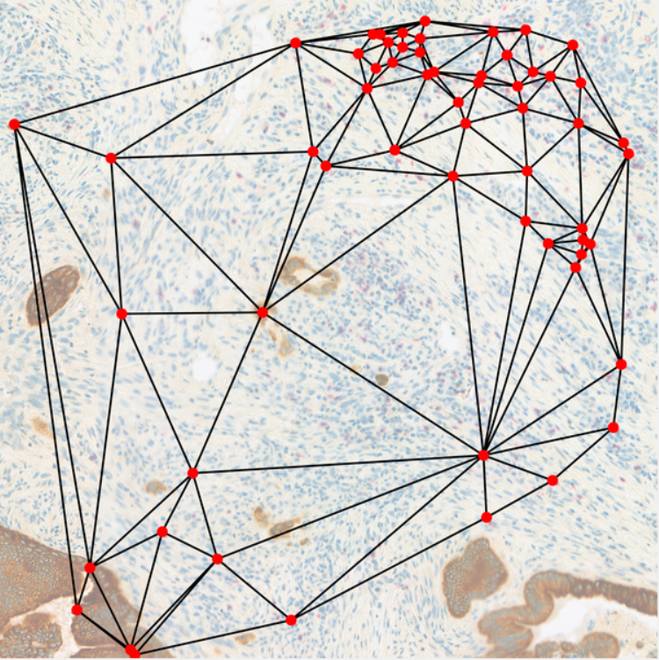
Draw graph
Open GXL file
Parse GXL file (node and edge list)
Open image
For each node: draw a circle
For each edge: draw a line
Note: Library OpenCV enables to draw shapes on an image

Slide 20
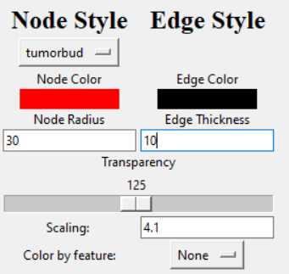
Graphical user interface (gui)
Change the appearance of the graph
Label
Button (selected node type)
Clickable label (color of node and edge)
Text entry (radius and edge thickness)
Scale bar (transparency of the background image)
Text entry (scaling of the graph)
Option menu (decide if nodes are colored by feature)
Note : Library tkinter enables to create the different components

Slide 21
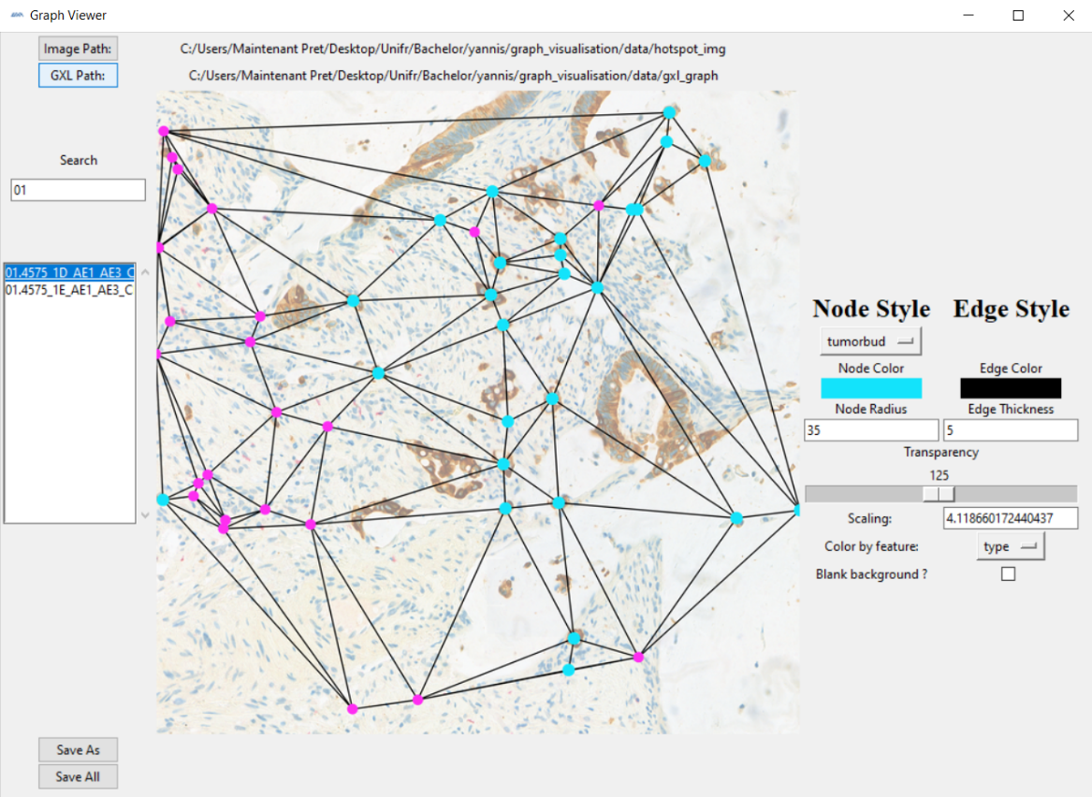
Result

Slide 22
Questions ?

